Slide 1
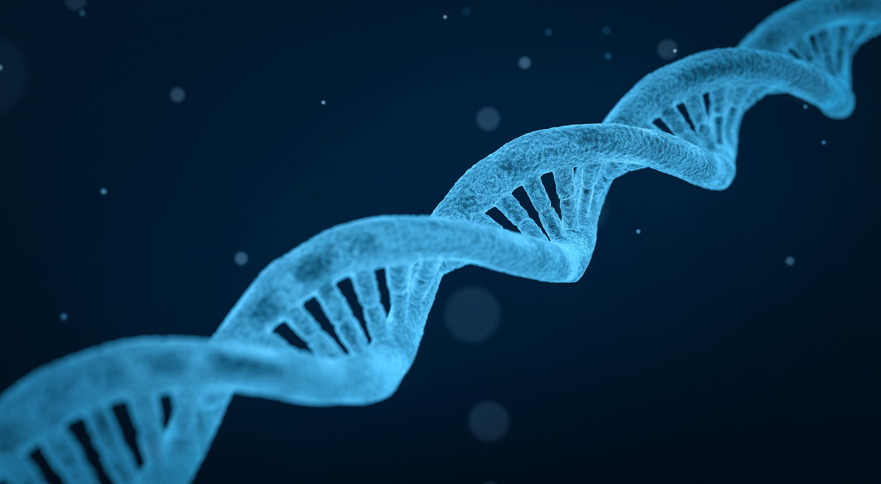
Community Detection
in
Biological
Networks
Prepared & Presented by Sultan Mamud and Firoj Hassan
Under the guidance of DBS Sir
MCA 3rd SEM 2021-23, University of Calcutta

Slide 2
Background:
Community detection algorithms are fundamental tools to uncover important features in networks.
There are several studies focused on social networks but only a few deal with biological networks.
We are interested in the detection of communities in biological networks.
Directly or indirectly, most of the methods maximize modularity i.e. a measure of the density of links within communities as compared to links between communities.
This work is multidisciplinary as it brings the field of biology and computer science in the broad sense.

Slide 3
Objective :
We focus more precisely on gene interaction networks. They represent protein-protein or gene-gene interactions.
A community in such networks corresponds to a set of proteins or genes that collaborate at the same cellular function.
Our goal is to identify such network or community from gene annotation sources such as Gene Ontology (GO).
These communities will give us an idea about the perception of the network’s structure.

Slide 4
Important Terms:
Biological pathways databases:
Reactome: is an open source, open access, manually curated, peer-reviewed pathway database of human pathways and processes. The basic unit used to describe the data is the reaction
Biocarta: concerns several species. It makes it possible to visualize, construct or identify the networks mapping the known genomic and proteomic relationships.
Wikipathway: is a database of multi-species metabolic pathways.
KEGG: Kyoto Encyclopedia of Genes and Genomes KEGG is a database resource for understanding high-level functions and utilities of the biological system, such as the cell, the organism and the ecosystem, from molecular-level information, especially large-scale molecular datasets generated by genome sequencing and other high-throughput experimental technologies.
The biological pathway database used to test the proposed approach is KEGG

Slide 5
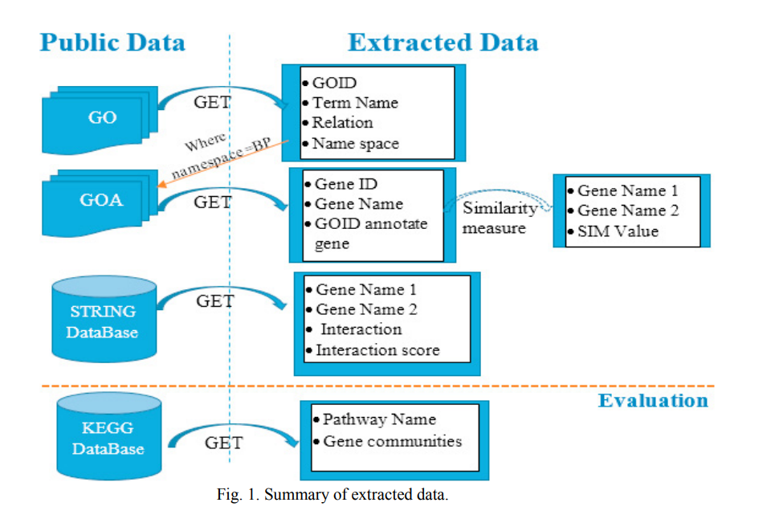
Summary :

Slide 6
Semantic Similarity based on GO:
A gene can be annotated by several GO terms.
To calculate the similarity between two genes, we need to use an approach allowing to compare sets of terms that annotate these genes thus we can quantify the similarity between these sets.
There are three main approaches for measuring semantic similarity between the objects of an ontology.
1. Node based approach
2. Edge based approach
3. Hybrid approach
Percentage of obtained similar gene pairs by different measures.
Networks Resnik Jiang Lin Rel Wang
R1 61/1891 78/1891 68/1891 68/1891 855/1891
R2 13/55 33/55 37/55 31/55 31/55
Average rate: 9.09% 16.68% 17.95% 18.17% 44.05%
using open source package GOSemSim

Slide 7
Comparison of Community Detection Algorithms:
Comparison of community detection algorithms, namely, Combo, Conclude, Fast Greedy, Leading Eigen, Louvain and Spinglass on two important biological networks to find their communities and evaluate the results in terms of topological and functional features through Kyoto Encyclopedia of Genes and Genomes pathway and Gene Ontology term enrichment analysis.
assessment criteria:
appropriate community size
only one or two broad biological functions
genes from the network belonging to a pathway should also belong to only one or two communities
performance speed
The first network in this study is a network of Protein-Protein Interactions (PPI) in Saccharomyces cerevisiae (Yeast) with 6532 nodes and 229,696 edges and the second is a network of PPI in Homo sapiens (Human) with 20,644 nodes and 241,008 edges

Slide 8
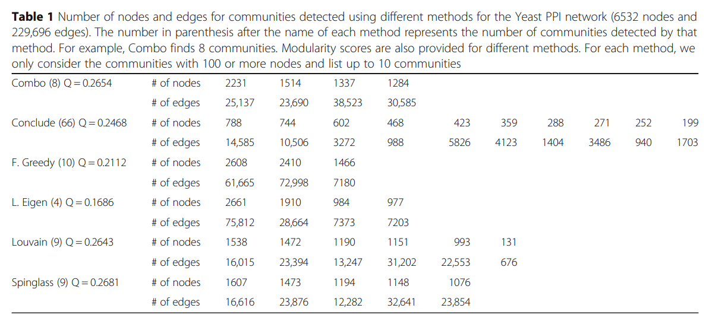
Comparison of Community Detection Algorithms:
Comparison based on topological features of communities

Slide 9
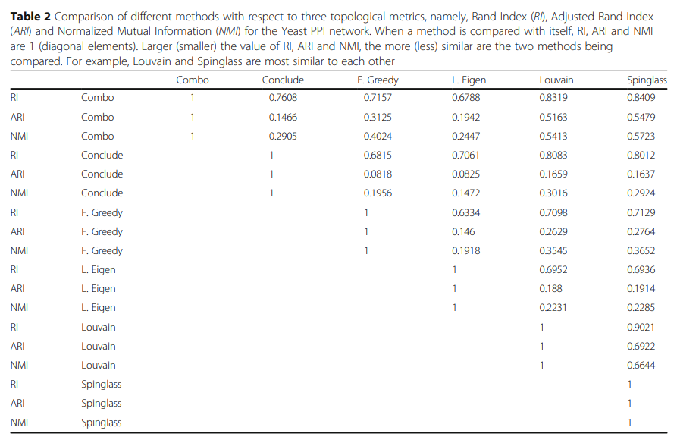
Comparison of Community Detection Algorithms:
Comparison based on biological/functional features of communities

